Slide 1
Verification Aided Regression Testing (VART)
ISSTA 2014
Accepted
Fabrizio Pastore,
Leonardo Mariani
University of Milano - Bicocca
Antti E. J. Hyvarinen,
Grigory Fedyukovich, Natasha Sharygina
University of Lugano
Stephan Sehestedt
ABB Germany
Ali Muhammad
VTT Finland
PINCETTE
Notes:
verification aided regression testing, a technique that augment regression testing withautomated verification capabilities.

Slide 2
Regression Failures
Base
Program
Upgraded
Program
working
no longer
working

Slide 3
Traditional Regression Testing
Base
Program
Upgraded
Program
Test Case
Test Case
Test Case
Write tests for Base

Slide 4
Traditional Regression Testing
Base
Program
Upgraded
Program
Test Case
Test Case
Test Case
Execute
Write tests for Base
Re-Execute
on Upgraded

Slide 5
Traditional Regression Testing
Base
Program
Upgraded
Program
Test Case
Test Case
Test Case
Execute
PROBLEM: Base Test inputs might not trigger the regression
Write tests for Base
Re-Execute
on Upgraded

Slide 6
Traditional Regression Testing
Base
Program
Upgraded
Program
Show Properties
Not Valid
in Upgraded
Test Case
Test Case
Test Case
Execute
Monitor + Inference
Model
Checking
Properties

Slide 7
Base Version
Upgraded Version
int isAvailable(node* product){
if ( notInitialized(product) )
return 0;
if ( product->items > 0 )
return 1;
return 0;
}
int isAvailable(node* product){
if ( notInitialized(product) )
return 0;
if ( product->in_catalog == 0 )
return -1;
if ( product->items > 0 )
return 1;
return 0;
}
Base Version:
total >= 0
long availableProducts( t_store* store ){
node* product = store->products;
long total = 0;
while ( product != 0 ) {
total += isAvailable( product );
product = product->nxt;
Upgraded Version:
total >= 0 FALSE
}
return total;
Notes:
... we want to drive properties that allow to detect the presence of a bug, so the first step we do is to monitor the softwrae and derive the properties
fault not revealed by tests

Slide 8
Tests for Base
Base Program
Upgraded Program
Monitoring + Inference
Dynamic Properties for Base

Slide 9
10
11
12
13
14
15
16
int isAvailable(node* product){
if ( notInitialized (product) )
return 0;
if ( product->items > 0 )
return 1;
return 0;
}
17
18
19
20
21
22
23
24
25
26
long availableProducts( t_store* store ){
node* product = store->products;
long total = 0;
while ( product != 0 ) {
total += isAvailable( product );
product = product->nxt;
}
return total;
}
Notes:
VART monitors the functions that are more likely impatced by the change, the modified function, its callers and its callees

Slide 10
int isAvailable(node* product){
if ( notInitialized (product) )
return 0;
if ( product->items > 0 )
return 1;
return 0;
}
10
11
12
13
14
15
16
product.items
0
3
2
5
product.name
MacBookPro
Dell
MacBookAir
AcerAspire
return
0
1
1
1
17
18
19
20
21
22
23
24
25
26
long availableProducts( t_store* store ){
node* product = store->products;
long total = 0;
while ( product != 0 ) {
total += isAvailable( product );
product = product->nxt;
}
return total;
}
total
0
1
2
3
product.items
0
3
2
5
return
3
Notes:
The result of the monitoring is to have the concrete data observed at runtime for the variables in the scope of the monitored program points

Slide 11
int isAvailable(node* product){
if ( notInitialized (product) )
return 0;
if ( product->items > 0 )
return 1;
return 0;
}
10
11
12
13
14
15
16
product.items
0
3
2
5
product.name
MacBookPro
Dell
MacBookAir
AcerAspire
return
0
1
1
1
17
18
19
20
21
22
23
24
25
26
long availableProducts( t_store* store ){
node* product = store->products;
long total = 0;
while ( product != 0 ) {
total += isAvailable( product );
product = product->nxt;
}
return total;
}
total
0
1
2
3
product.items
0
3
2
5
return
3
Notes:
The result of the monitoring is to have the concrete data observed at runtime for the variables in the scope of the monitored program points

Slide 12
int isAvailable(node* product){
if ( notInitialized (product) )
return 0;
if ( product->items > 0 )
return 1;
return 0;
}
10
11
12
13
14
15
16
product.items
0
3
2
5
product.name
MacBookPro
Dell
MacBookAir
AcerAspire
return
0
1
1
1
Inference with
Daikon [Ernst et al.]
17
18
19
20
21
22
23
24
25
26
long availableProducts( t_store* store ){
node* product = store->products;
long total = 0;
while ( product != 0 ) {
total += isAvailable( product );
product = product->nxt;
}
return total;
}
total
0
1
2
3
product.items
0
3
2
5
return
3
Notes:
The result of the monitoring is to have the concrete data observed at runtime for the variables in the scope of the monitored program points

Slide 13
10
11
12
13
14
15
16
int isAvailable(node* product){
if ( notInitialized (product) )
return 0;
if ( product->items > 0 )
return 1;
return 0;
}
product.items >= 0
product.name
MacBookPro
Dell
MacBookAir
AcerAspire
return
0
1
1
1
Inference with
Daikon [Ernst et al.]
17
18
19
20
21
22
23
24
25
26
long availableProducts( t_store* store ){
node* product = store->products;
long total = 0;
while ( product != 0 ) {
total += isAvailable( product );
product = product->nxt;
}
return total;
}
total
0
1
2
3
product.items
0
3
2
5
return
3
Notes:
The result of the monitoring is to have the concrete data observed at runtime for the variables in the scope of the monitored program points

Slide 14
10
11
12
13
14
15
16
int isAvailable(node* product){
if ( notInitialized (product) )
return 0;
if ( product->items > 0 )
return 1;
return 0;
}
product.items >= 0
product.name
MacBookPro
Dell
MacBookAir
AcerAspire
return one of {0,1}
Inference with
Daikon [Ernst et al.]
17
18
19
20
21
22
23
24
25
26
long availableProducts( t_store* store ){
node* product = store->products;
long total = 0;
while ( product != 0 ) {
total += isAvailable( product );
product = product->nxt;
}
return total;
}
total
0
1
2
3
product.items
0
3
2
5
return
3
Notes:
The result of the monitoring is to have the concrete data observed at runtime for the variables in the scope of the monitored program points

Slide 15
10
11
12
13
14
15
16
int isAvailable(node* product){
if ( notInitialized (product) )
return 0;
if ( product->items > 0 )
return 1;
return 0;
}
product.items >= 0
product.name
MacBookPro
Dell
MacBookAir
AcerAspire
return one of {0,1}
Inference with
Daikon [Ernst et al.]
17
18
19
20
21
22
23
24
25
26
long availableProducts( t_store* store ){
node* product = store->products;
long total = 0;
while ( product != 0 ) {
total += isAvailable( product );
product = product->nxt;
}
return total;
}
total >= 0
product.items
0
3
2
5
return
3
Notes:
The result of the monitoring is to have the concrete data observed at runtime for the variables in the scope of the monitored program points

Slide 16
10
11
12
13
14
15
16
int isAvailable(node* product){
if ( notInitialized (product) )
return 0;
if ( product->items > 0 )
return 1;
return 0;
}
product.items >= 0
return one of {0,1}
Inference with
Daikon [Ernst et al.]
17
18
19
20
21
22
23
24
25
26
long availableProducts( t_store* store ){
node* product = store->products;
long total = 0;
while ( product != 0 ) {
total += isAvailable( product );
product = product->nxt;
}
return total;
}
total >= 0
product.items >= 0
return one of {0,3}
Overfitting
Notes:
The result of the monitoring is to have the concrete data observed at runtime for the variables in the scope of the monitored program points

Slide 17
Tests for Base
Base Program
Upgraded Program
Monitoring + Inference
Dynamic Properties for Base

Slide 18
Bounded Model Checker
main(..)
Tests for Base
Base Program
drawProductBox(..)
Monitoring + Inference
availableItems(..) {
. . .
while ( .. ) {
..
}
assert( total > 0 )
Dynamic Properties for Base
Intra-Version
Property Verification
isAvailable(..)
Verified Properties
for Base
notInitialized(..)

Slide 19
EvolCheck
main(..)
Tests for Base
Base Program
drawProductBox(..)
Monitoring + Inference
availableItems(..) {
. . .
while ( .. ) {
..
}
assert( total > 0 )
Dynamic Properties for Base
Intra-Version
Property Verification
isAvailable(..)
Verified Properties
for Base
notInitialized(..)
function summaries

Slide 20
10
11
12
13
14
15
16
int isAvailable(node* product){
if ( notInitialized (product) )
return 0;
if ( product->items > 0 )
return 1;
return 0;
}
product.items >= 0
return one of {0,1}
17
18
19
20
21
22
23
24
25
26
long availableProducts( t_store* store ){
node* product = store->products;
long total = 0;
while ( product != 0 ) {
total += isAvailable( product );
product = product->nxt;
}
return total;
}
total >= 0
return one of {2, 3}

Slide 21
10
11
12
13
14
15
16
int isAvailable(node* product){
assert( product->items >= 0 )
if ( notInitialized (product) )
return 0;
if ( product->items > 0 )
return 1;
return 0;
}
return one of {0,1}
17
18
19
20
21
22
23
24
25
26
long availableProducts( t_store* store ){
node* product = store->products;
long total = 0;
while ( product != 0 ) {
total += isAvailable( product );
product = product->nxt;
}
return total;
}
total >= 0
return one of {2, 3}

Slide 22
10
11
12
13
14
15
16
int isAvailable(node* product){
assert( product->items >= 0 )
if ( notInitialized (product) )
{ int ret_0=0; assert(ret_0 == 0 || ret_0 == 1); return ret_0; }
if ( product->items > 0 )
{ int ret_1=0; assert(ret_1 == 0 || ret_0 == 1); return ret_1; }
int ret_2=0; assert(ret_2 == 0 || ret_2 == 1); return ret_2;
}
17
18
19
20
21
22
23
24
25
26
long availableProducts( t_store* store ){
node* product = store->products;
long total = 0;
while ( product != 0 ) {
total += isAvailable( product );
product = product->nxt;
}
return total;
}
total >= 0
return one of {2, 3}

Slide 23
10
11
12
13
14
15
16
int isAvailable(node* product){
assert( product->items >= 0 )
if ( notInitialized (product) )
{ int ret_0=0; assert(ret_0 == 0 || ret_0 == 1); return ret_0; }
if ( product->items > 0 )
{ int ret_1=0; assert(ret_1 == 0 || ret_0 == 1); return ret_1; }
int ret_2=0; assert(ret_2 == 0 || ret_2 == 1); return ret_2;
}
17
18
19
20
21
22
23
24
25
26
long availableProducts( t_store* store ){
node* product = store->products;
long total = 0;
while ( product != 0 ) {
total += isAvailable( product );
assert( total >= 0 );
product = product->nxt;
}
return total;
}
return one of {2, 3}

Slide 24
10
11
12
13
14
15
16
int isAvailable(node* product){
assert( product->items >= 0 )
if ( notInitialized (product) )
{ int ret_0=0; assert(ret_0 == 0 || ret_0 == 1); return ret_0; }
if ( product->items > 0 )
{ int ret_1=0; assert(ret_1 == 0 || ret_0 == 1); return ret_1; }
int ret_2=0; assert(ret_2 == 0 || ret_2 == 1); return ret_2;
}
17
18
19
20
21
22
23
24
25
26
long availableProducts( t_store* store ){
node* product = store->products;
long total = 0;
while ( product != 0 ) {
total += isAvailable( product );
assert( total >= 0 );
product = product->nxt;
}
long ret_0 = total; assert (ret_0 == 0 || ret_0 == 3); return ret_0;
}

Slide 25
10
11
12
13
14
15
16
int isAvailable(node* product){
assert( product->items >= 0 )
if ( notInitialized (product) )
{ int ret_0=0; assert(ret_0 == 0 || ret_0 == 1); return ret_0; }
if ( product->items > 0 )
{ int ret_1=0; assert(ret_1 == 0 || ret_0 == 1); return ret_1; }
int ret_2=0; assert(ret_2 == 0 || ret_2 == 1); return ret_2;
}
Execute Model Checker
on source with assertions
classifies
17
18
19
20
21
22
23
24
25
26
long availableProducts( t_store* store ){
node* product = store->products;
long total = 0;
while ( product != 0 ) {
total += isAvailable( product );
assert( total >= 0 );
product = product->nxt;
}
long ret_0 = total; assert (ret_0 == 0 || ret_0 == 3); return ret_0;
}
Verified
Unreachable
False
Unknown

Slide 26
10
11
12
13
14
15
16
int isAvailable(node* product){
assert( product->items >= 0 )
if ( notInitialized (product) )
{ int ret_0=0; assert(ret_0 == 0 || ret_0 == 1); return ret_0; }
if ( product->items > 0 )
{ int ret_1=0; assert(ret_1 == 0 || ret_0 == 1); return ret_1; }
int ret_2=0; assert(ret_2 == 0 || ret_2 == 1); return ret_2;
}
Execute Model Checker
on source with assertions
classifies
17
18
19
20
21
22
23
24
25
26
long availableProducts( t_store* store ){
node* product = store->products;
long total = 0;
while ( product != 0 ) {
total += isAvailable( product );
assert( total >= 0 );
product = product->nxt;
}
long ret_0 = total; assert (ret_0 == 0 || ret_0 == 3); return ret_0;
}
Verified
Unreachable
False
Unknown
Verified Properties
for Base

Slide 27
Phase 2: Checking
Tests for Base
Base Program
Monitoring + Inference
Dynamic Properties for Base
Intra-Version
Property Verification
Verified Properties
for Base
Notes:
We just identified properties that are true for the base version of the software and we could use them to check if all are preserved by the upgrade

Slide 28
Phase 2: Checking
Verified Properties
for Base
Tests for Base
Base Program
Upgraded Program
Tests for Upgrade
Monitoring + Inference
Monitoring + Filtering
DISCARD
Dynamic Properties for Base
Non-Regression Properties
Outdated
Properties
Intra-Version
Property Verification
Verified Properties
for Base
Notes:
We have a change so we might expect that some properties are outdated because of the change itself.
To identify the outdated properties we rely upon the fact that developers write test cases to check their changes.
So we assume that all the properties that are invalidate by data observed during the execution of a passing test case, could be considered intentionally changed by the developers.

Slide 29
Base
Upgrade
10
11
12
13
14
15
16
int isAvailable(node* product){
if ( notInitialized (product) )
return 0; return -1;
if ( product->items > 0 )
return 1;
return 0;
}
int isAvailable(node* product){
if ( notInitialized (product) )
return 0;
if ( notInCatalog (product) )
return -1;
if ( product->items > 0 )
return 1;
return 0;
}
10
11
12
13
14
15
16
17
18
18
19
20
21
22
23
24
25
26
27
long availableProducts( t_store* store ){
node* product = store->products;
long total = 0;
while ( product != 0 ) {
total += isAvailable( product );
product = product->nxt;
}
return total;
}
20
21
22
23
24
25
26
27
28
29
long availableProducts( t_store* store ){
node* product = store->products;
long total = 0;
while ( product != 0 ) {
total += isAvailable( product );
product = product->nxt;
}
return total;
}

Slide 30
Base
Upgrade
10
11
12
13
14
15
16
int isAvailable(node* product){
if ( notInitialized (product) )
return 0;
return -1;
if ( product->items > 0 )
return 1;
return 0;
}
int isAvailable(node* product){
if ( notInitialized (product) )
return 0;
if ( notInCatalog (product) )
return -1;
if ( product->items > 0 )
return 1;
return 0;
}
10
11
12
13
14
15
16
17
18
18
19
20
21
22
23
24
25
26
27
long availableProducts( t_store* store ){
node* product = store->products;
long total = 0;
while ( product != 0 ) {
total += isAvailable( product );
product = product->nxt;
}
return total;
}
20
21
22
23
24
25
26
27
28
29
long availableProducts( t_store* store ){
node* product = store->products;
long total = 0;
while ( product != 0 ) {
total += isAvailable( product );
product = product->nxt;
}
return total;
}

Slide 31
Base
product->items >= 0
Upgrade
10
11
12
13
14
15
16
int isAvailable(node* product){
if ( notInitialized (product) )
return 0;
return -1;
if ( product->items > 0 )
return 1;
return 0;
}
int isAvailable(node* product){
if ( notInitialized (product) )
return 0;
if ( notInCatalog (product) )
return -1;
if ( product->items > 0 )
return 1;
return 0;
}
10
11
12
13
14
15
16
17
18
return one of {0,1}
18
19
20
21
22
23
24
25
26
27
long availableProducts( t_store* store ){
node* product = store->products;
long total = 0;
while ( product != 0 ) {
total += isAvailable( product );
product = product->nxt;
}
return total;
}
20
21
22
23
24
25
26
27
28
29
long availableProducts( t_store* store ){
node* product = store->products;
long total = 0;
while ( product != 0 ) {
total += isAvailable( product );
product = product->nxt;
}
return total;
}
total >= 0
Notes:
this way VART can take the properties derived for the base version and easily map the m on th eupgraded version

Slide 32
Base
product->items >= 0
Upgrade
10
11
12
13
14
15
16
int isAvailable(node* product){
if ( notInitialized (product) )
return 0;
return -1;
if ( product->items > 0 )
return 1;
return 0;
}
int isAvailable(node* product){
if ( notInitialized (product) )
return 0;
if ( notInCatalog (product) )
return -1;
if ( product->items > 0 )
return 1;
return 0;
}
10
11
12
13
14
15
16
17
18
return one of {0,1}
18
19
20
21
22
23
24
25
26
27
long availableProducts( t_store* store ){
node* product = store->products;
long total = 0;
while ( product != 0 ) {
total += isAvailable( product );
product = product->nxt;
}
return total;
}
20
21
22
23
24
25
26
27
28
29
long availableProducts( t_store* store ){
node* product = store->products;
long total = 0;
while ( product != 0 ) {
total += isAvailable( product );
product = product->nxt;
}
return total;
}
total >= 0

Slide 33
Upgrade
product->items >= 0
10
11
12
13
14
15
16
17
18
int isAvailable(node* product){
if ( notInitialized (product) )
return 0;
if ( notInCatalog (product) )
return -1;
if ( product->items > 0 )
return 1;
return 0;
}
Test for the upgrade
return one of {0,1}
void testNotInCatalog(){
list_node* prod = create_product();
prod->name = “MacBook”;
prod->in_catalog = 0;
assertEquals(-1,isAvailable(prod));
}
20
21
22
23
24
25
26
27
28
29
long availableProducts( t_store* store ){
node* product = store->products;
long total = 0;
while ( product != 0 ) {
total += isAvailable( product );
product = product->nxt;
}
return total;
}
total >= 0

Slide 34
Upgrade
product->items >= 0
10
11
12
13
14
15
16
17
18
int isAvailable(node* product){
if ( notInitialized (product) )
return 0;
if ( notInCatalog (product) )
return -1;
if ( product->items > 0 )
return 1;
return 0;
}
product.items
0
product.in_catalog
0
product.name
MacBook
return
-1
Test for the upgrade
return one of {0,1}
void testNotInCatalog(){
list_node* prod = create_product();
prod->name = “MacBook”;
prod->in_catalog = 0;
assertEquals(-1,isAvailable(prod));
}
20
21
22
23
24
25
26
27
28
29
long availableProducts( t_store* store ){
node* product = store->products;
long total = 0;
while ( product != 0 ) {
total += isAvailable( product );
product = product->nxt;
}
return total;
}
total >= 0
Notes:
intentional change violates properties , property outdated

Slide 35
Phase 2: Checking
Verified Properties
for Base
Tests for Base
Base Program
Upgraded Program
Tests for Upgrade
Monitoring + Inference
Monitoring + Filtering
Dynamic Properties for Base
Non-Regression Properties
Intra-Version
Property Verification
Verified Properties
for Base

Slide 36
Phase 2: Checking
Verified Properties
for Base
Tests for Base
Base Program
Upgraded Program
Tests for Upgrade
Monitoring + Inference
Monitoring + Filtering
Dynamic Properties for Base
Non-Regression Properties
Intra-Version
Property Verification
Inter-Version
Property Verification
Verified Properties
for Base
Regression Problems + Counterexamples

Slide 37
10
11
12
13
14
15
16
17
18
int isAvailable(node* product){
assert( product->items >= 0 );
if ( notInitialized (product) )
return 0;
if ( notInCatalog (product) )
return -1;
if ( product->items > 0 )
return 1;
return 0;
}
classifies
17
18
19
20
21
22
23
24
25
26
long availableProducts( t_store* store ){
node* product = store->products;
long total = 0;
while ( product != 0 ) {
total += isAvailable( product );
assert( total >= 0 );
product = product->nxt;
}
return total;
}

Slide 38
10
11
12
13
14
15
16
17
18
int isAvailable(node* product){
assert( product->items >= 0 );
if ( notInitialized (product) )
return 0;
if ( notInCatalog (product) )
return -1;
if ( product->items > 0 )
return 1;
return 0;
}
Execute Model Checker
on source with assertions
classifies
17
18
19
20
21
22
23
24
25
26
long availableProducts( t_store* store ){
node* product = store->products;
long total = 0;
while ( product != 0 ) {
total += isAvailable( product );
assert( total >= 0 );
product = product->nxt;
}
return total;
}
Verified
False
Unreachable
Unknown

Slide 39
10
11
12
13
14
15
16
17
18
int isAvailable(node* product){
assert( product->items >= 0 );
if ( notInitialized (product) )
return 0;
if ( notInCatalog (product) )
return -1;
if ( product->items > 0 )
return 1;
return 0;
}
Execute Model Checker
on source with assertions
classifies
17
18
19
20
21
22
23
24
25
26
long availableProducts( t_store* store ){
node* product = store->products;
long total = 0;
while ( product != 0 ) {
total += isAvailable( product );
assert( total >= 0 );
product = product->nxt;
}
return total;
}
Verified
False
Unreachable
Unknown
FALSE
Presented to developers

Slide 40
10
11
12
13
14
15
16
17
18
int isAvailable(node* product){
assert( product->items >= 0 );
if ( notInitialized (product) )
return 0;
if ( notInCatalog (product) )
return -1;
if ( product->items > 0 )
return 1;
return 0;
}
Execute Model Checker
on source with assertions
classifies
17
18
19
20
21
22
23
24
25
26
long availableProducts( t_store* store ){
node* product = store->products;
long total = 0;
while ( product != 0 ) {
total += isAvailable( product );
assert( total >= 0 );
product = product->nxt;
}
return total;
}
Verified
False
Unreachable
Unknown
FALSE
Presented to developers

Slide 41
Verified Properties
for Base
Tests for Base
Base Program
Upgraded Program
Tests for Upgrade
Monitoring + Inference
Monitoring + Filtering
Dynamic Properties for Base
Non-Regression Properties
Intra-Version
Property Verification
Inter-Version
Property Verification
Verified Properties
for Base
Regression Problems + Counterexamples

Slide 42
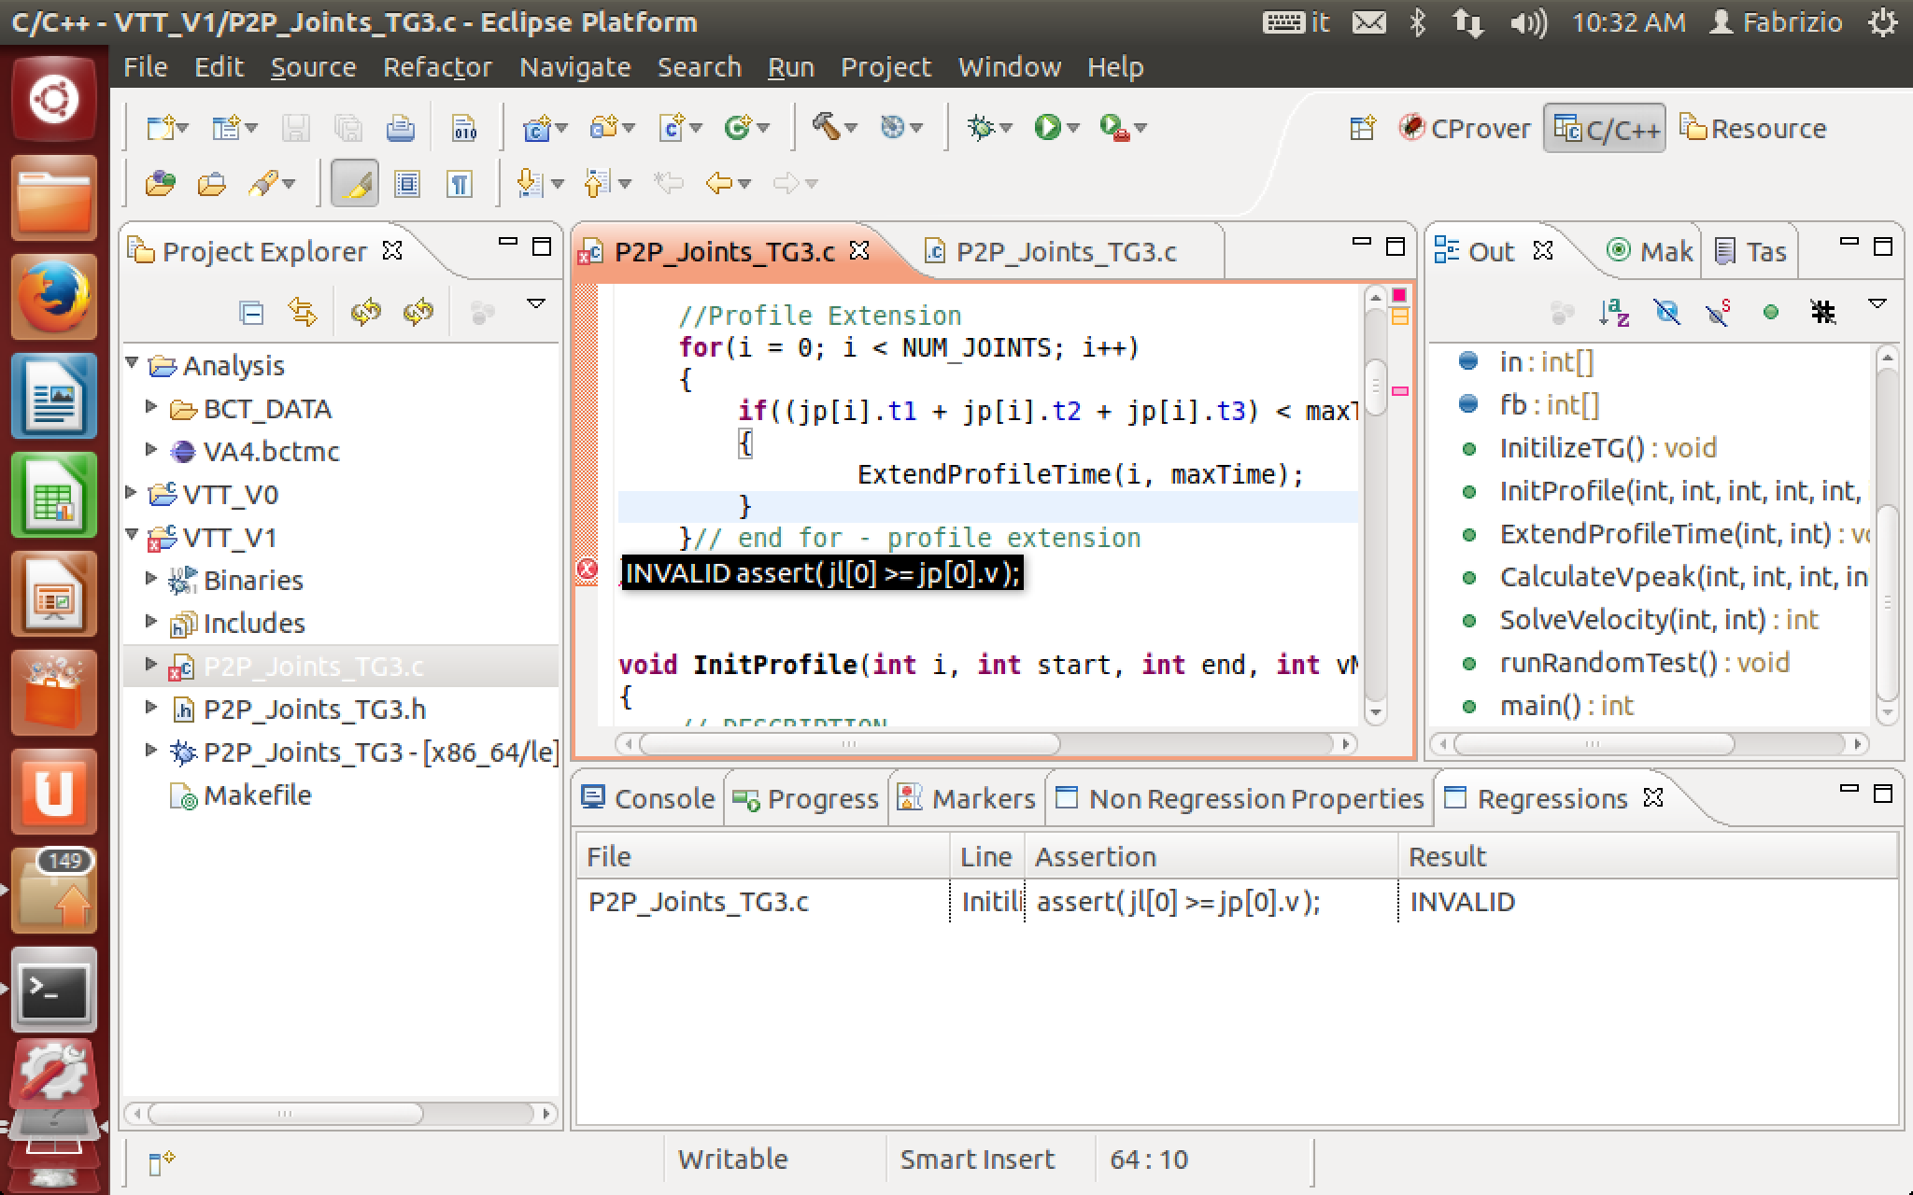
Tool Implementation
WWW.LTA.DISCO.UNIMIB.IT/TOOLS/VART
Console Version
Eclipse GUI

Slide 43
Empirical Validation
Effectiveness wrt Test Coverage
Effectiveness with Regression Faults not covered by Test Suites
Notes:
The empirical validation of VART regarded two sets of experiments.
The first aimed at evaluating the efect of test cases coverage on the effectiveness of the technique,
The second capability of the technique in identifying non trivial faults not covered by test cases

Slide 44
Effectiveness wrt Test Coverage
Poor Tests
Extensive Tests
Poor Properties
Complete Properties
Low Coverage
High Coverage
Notes:
VART derives models from test cases executions, with high coverage we expect to get complete properties that help finding more regressions, but at the same time high coverage means extensive tests that already catch most of the regressions. Test cases with low coverage do not catch most of the regressions, but lower coverage may lead to less effective properties.
The goal of this experiment is to evaluate the COMPLEMENTARITY between VART and test suites

Slide 45
Effectiveness vs Test Coverage
Poor Tests
Extensive Tests
Poor Properties
Complete Properties
Low Coverage
High Coverage
GREP, 871 Test Cases
Faulty Versions of GREP from Software-artifacts Infrastructure Repository (SIR) http://sir.unl.edu
Selected all the faulty versions derived from GREP v3 and v4, with faults covered by test cases
Notes:
To perform this experiment we needed a software with faults and an extensive test suite, to tis end we considered the versions of GREP provided by the SIR.
Since we want to evaluate the complementarity between test cases and VART we considered faults that are discovered by the test suite.

Slide 46
Fault ID | Base Version | Upgrade Version | Change Size
v3 DG10 | 10/6/1999 16:44:13 | 10/6/1999 1:13:21 | 483
v3 KP2
v3 KP9
v3 DG1 | 8/13/1999 14:45:21 | 8/13/1999 15:02:00 | 944
v3 DG8
v3 KP7
v3 DG3 | 10/07/1999 3:42:57 | 10/12/1999 4:11:40 | 185
v3 DG2
v4 KP8 | 1/21/2000 2:22:47 | 1/25/2000 3:34:23 | 354
v4 DG3
v4 KP6 | 1/17/2000 0:55:06 | 1/20/2000 4:43:03 | 89

Slide 47
Deriving Regressions
Fault ID | Base Version | Upgrade Version | Change Size
v3 DG10 | 10/6/1999 16:44:13 | 10/6/1999 1:13:21 | 483
v3 KP2
v3 KP9
v3 DG1 | 8/13/1999 14:45:21 | 8/13/1999 15:02:00 | 944
v3 DG8
v3 KP7
v3 DG3 | 10/07/1999 3:42:57 | 10/12/1999 4:11:40 | 185
v3 DG2
v4 KP8 | 1/21/2000 2:22:47 | 1/25/2000 3:34:23 | 354
v4 DG3
v4 KP6 | 1/17/2000 0:55:06 | 1/20/2000 4:43:03 | 89
case ‘+‘:
return PLUS;
case ‘{‘:
c=FETCH();
if ( ! ISASCIIDIGIT (c) )
minrep = c - '0';
...
case ‘<’:
return BEGWORD;
Faulty Version of GREP
from SIR repository

Slide 48
Deriving Regressions
Base
Fault ID | Base Version | Upgrade Version | Change Size
v3 DG10 | 10/6/1999 16:44:13 | 10/6/1999 1:13:21 | 483
v3 KP2
v3 KP9
v3 DG1 | 8/13/1999 14:45:21 | 8/13/1999 15:02:00 | 944
v3 DG8
v3 KP7
v3 DG3 | 10/07/1999 3:42:57 | 10/12/1999 4:11:40 | 185
v3 DG2
v4 KP8 | 1/21/2000 2:22:47 | 1/25/2000 3:34:23 | 354
v4 DG3
v4 KP6 | 1/17/2000 0:55:06 | 1/20/2000 4:43:03 | 89
case ‘+‘:
return PLUS;
case ‘<’:
return BEGWORD;
case ‘+‘:
return PLUS;
case ‘{‘:
c=FETCH();
if ( ! ISASCIIDIGIT (c) )
minrep = c - '0';
...
case ‘<’:
return BEGWORD;
Upgrade
case ‘+‘:
return PLUS;
case ‘{‘:
c=FETCH();
if ( ISASCIIDIGIT (c) )
minrep = c - '0';
...
case ‘<’:
return BEGWORD;
!
Faulty Version of GREP
from SIR repository
Most Recent Change
from GREP repository
+ injected fault

Slide 49
Fault ID | Base Version | Upgrade Version | Change Size
v3 DG10 | 10/6/1999 16:44:13 | 10/6/1999 1:13:21 | 483
v3 KP2
v3 KP9
v3 DG1 | 8/13/1999 14:45:21 | 8/13/1999 15:02:00 | 944
v3 DG8
v3 KP7
v3 DG3 | 10/07/1999 3:42:57 | 10/12/1999 4:11:40 | 185
v3 DG2
v4 KP8 | 1/21/2000 2:22:47 | 1/25/2000 3:34:23 | 354
v4 DG3
v4 KP6 | 1/17/2000 0:55:06 | 1/20/2000 4:43:03 | 89
Notes:
We have a total of 11 faults, the faults affect instructions modified in 5 different commits by software developers idnetified in the table by the commit date of the base and upgraded version of the repository.

Slide 50
✔
 |  | TC1 | TC2 | TC3 | TC4 | ... | TC817
Notes:
GREP comes with an extensive test suite that cover branches multiple times.

Slide 51
✔
Functions |  | TC1 | TC2 | TC3 | TC4 | ... | TC817
copy(..) | branch1 |  |  |  |  |  | ✔
 | branch2 | ✔
 | branch3 | ✔ |  | ✔ |  |  | ✔
lex(..) | branch1 |  |  | ✔
 | branch2 | ✔ | ✔ |  | ✔
 | branch3 |  |  |  |  |  | ✔
main(..) | branch1 |  | ✔ |  | ✔ |  | ✔
 | branch2
...
Modified
MINIMAL REGRESSION TEST SUITE
Notes:
Multiple executions of a same branch may improve the quality of models, to limit the bias introduced by multiple executions of a same branch we built a minimal test suite in a way that is often used by softwrae developers when running regression tests, for each subject we first identified a minimal test suite that cover all the branches of the modified function

Slide 52
50%
Incremental Coverage
20%
TC1
TC817
TC3
TC..
TC..
TC..
20%
50%
MRT
(75%)
Notes:
We ordered the test cases in MRT in a greedy fashion, so that the first test case is the one that contributes most to the coverage while the last test case is the one that contributes least to the coverage.

Slide 53
Coverage | Identified Faults |  | Property Violations
Fault ID | Regression Testing | VART | TP | FP
Coverage 20% | 3 | 5 | 5 | 0
Coverage 50% | 7 | 8 | 2 | 0
Minimal Regression Test Suite | 10 | 10 | 0 | 0
(coverage 75%)

Slide 54
Coverage | 20% |  | 50% |  | MRT
Fault ID | Test | VART | Test | VART | Test | VART
v3 DG10 | 0 | 0 | 1 | 1 | 1 | 1
v3 KP2 | 0 | 1 | 1 | 1 | 1 | 1
v3 KP9 | 0 | 0 | 0 | 0 | 0 | 0
v3 DG1 | 0 | 0 | 0 | 0 | 1 | 1
v3 DG8 | 0 | 0 | 0 | 1 | 1 | 1
v3 KP7 | 0 | 0 | 0 | 0 | 1 | 1
v3 DG3 | 1 | 1 | 1 | 1 | 1 | 1
v3 DG2 | 1 | 1 | 1 | 1 | 1 | 1
v4 KP8 | 0 | 1 | 1 | 1 | 1 | 1
v4 DG3 | 1 | 1 | 0 | 0 | 1 | 1
v4 KP6 | 0 | 0 | 1 | 0 | 1 | 1

Slide 55
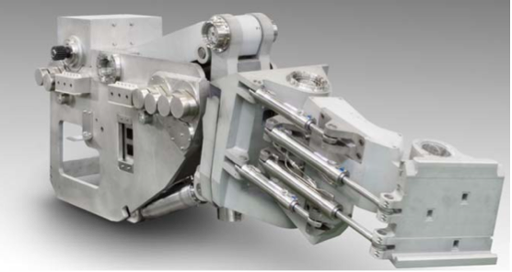
Effectiveness with Regression Faults
Not Covered by Test Suites
VTT: Motion Trajectory
Controller
Notes:
We are not interested only in understanding if VART helps finding faults when test cases are not good but also to understand whether VART spots non trivial regressions not covered by test suites. So we considered 6 case faults affecting two industrial and two open source software.

Slide 56
Effectiveness with Regression Faults
Not Covered by Test Suites
Subject | Size (LOC) | Base | Upgrade | Test Suite Size
VTT | 488 | 10.1 | 10.2 | 1000
VTT: Motion Trajectory
Controller
VTT: Motion Trajectory
Controller
Notes:
The first fault is a real fault that affects a software developed at VTT and is a motion trajectory controller software that calculates the speeds of the joints of the arm of a robot

Slide 57
Effectiveness with Regression Faults
Not Covered by Test Suites
Subject | Size (LOC) | Base | Upgrade | Test Suite Size
VTT | 488 | 10.1 | 10.2 | 1000
ABB-1 | 200 | - | - | 1600
ABB-2 | 200 | - | - | 1600
ABB-3 | 200 | - | - | 1600
VTT: Motion Trajectory
Controller
ABB: Protection Function
Notes:
Three faults affect a protection function developed by ABB. Since it is a very stable function we did not have recent regressions, so we injected 3 faults that simulate configuration problems and are not detected by the softwrae test suite. We thus obtained the 3 regressions by mutating the definition of the three con- stants that are used by the function to represent the actual system state.

Slide 58
Effectiveness with Regression Faults
Not Covered by Test Suites
Subject | Size (LOC) | Base | Upgrade | Test Suite Size
VTT | 488 | 10.1 | 10.2 | 1000
ABB-1 | 200 | - | - | 1600
ABB-2 | 200 | - | - | 1600
ABB-3 | 200 | - | - | 1600
SORT | 4653 | 20/06/2012 | 02/07/2012 | 427
GREP | 590 | 01/17/2001 | 01/20/2001 | 817
VTT: Motion Trajectory
Controller
Notes:
the other two faults affect two well known open source utilities to process text files, the unix program sort and grep

Slide 59
Subject | Dynamic Properties | Non-Regression Properties | Property Violations
 |  |  | TP | FP | Precision
VTT | 1045 | 658 | 15 | 0 | 1.00
ABB-1 | 3278 | 163 | 57 | 1 | 0.98
ABB-2 | 3278 | 163 | 57 | 1 | 0.98
ABB-3 | 3278 | 163 | 0 | 1 | 0.00
SORT | 356 | 2 | 1 | 0 | 1.00
GREP | 3303 | 51 | 3 | 0 | 1.00
Notes:
This tabe shows our findings, we can see that the number of dynamic properties is pretty huge and the filtering helps in removing a good number of invalid properities

Slide 60
Pre- and Post-conditions catch illegal uses of functions

Slide 61
New code with wrong use of base function
else if (*how == 'w’) {
if (ftruncate (outfd, 0) != 0)
error (EXIT_FAILURE, errno, _("%s: error truncating"), quote (file));
fp = fdopen (outfd, how);
Base
Upgrade
stream_open (char const *file, . . .
if (*how == 'r’) {
. . .
}
return fopen (file, how);
}
stream_open (char const *file,
. . .
if (*how == 'r’) {
. . .
}
else if (*how == 'w’) {
if (ftruncate (outfd, 0) != 0)
error (EXIT_FAILURE, . . .
fp = fdopen (outfd, how);
} else
return fp;
}
SORT_FAILURE
void error (int status, . . .
assert( status == 0 || status == 2 );

Slide 62
Unreachable assertions catch errors in branch conditions

Slide 63
Missing else: unreachable assertion
FETCH(c, _("unfinished repeat count"));
if (ISDIGIT(c))
{
minrep = c - '0';
for (;;)
{
FETCH(c, _("unfinished repeat count"));
if (!ISDIGIT(c))
break;
minrep = 10 * minrep + c - '0';
}
}
dfaerror(_("malformed repeat count"));
if (c == ',')
Base
Upgrade
if (ISDIGIT(c)) {
minrep = c - '0';
for (;;) {
...
minrep = 10 * minrep + c - '0';
}
}
else
dfaerror(_("malformed"));
if (c == ',’) {
. . .
for (;;) {
if (ISDIGIT(c)) {
minrep = c - '0';
for (;;) {
...
minrep = 10 * minrep + c - '0';
}
}
else if (c == ',’)
dfaerror(_("malformed"));
if (c == ',’){
for (;;) {
assert( c >= 44 );

Slide 64
Assertions identify the variables with wrong assignments

Slide 65
Wrong Refactoring
Base
Upgrade
! missing
if (count) {
status = 0;
if (list_files == 1)
printf ("%s\n", filename);
} else {
status = 1;
if (list_files == -1)
printf ("%s\n", filename);
}
status = count;
if (list_files == 1 - 2 * status)
printf ("%s%c", filename, '\n' & filename_mask);
assert( count != status );
assert( status <= 1 );
assert( desc >= 0 );

Slide 67
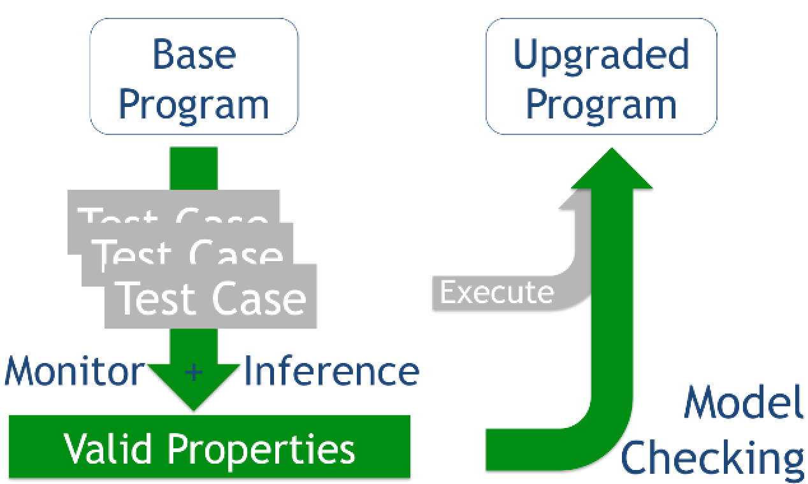
Verification Aided Regression Testing (VART)
Compensate Low
Test Coverage
Spot Regressions
Hard to Find
http://www.lta.disco.unimib.it/tools/vart/

