Slide 1
Verifying Programs by Evolving
(Under)-Approximations
Arie Gurfinkel
SEI / CMU
based on work with A. Komuravelli, S. Chaki, E. Clarke, A. Belov, and J. Marques-Silva
Notes:
Title Slide
Title and Subtitle text blocks should not be moved from their position if at all possible.

Slide 2
Copyright 2013 Carnegie Mellon University
This material is based upon work funded and supported by the Department of Defense under Contract No. FA8721-05-C-0003 with Carnegie Mellon University for the operation of the Software Engineering Institute, a federally funded research and development center.
Any opinions, findings and conclusions or recommendations expressed in this material are those of the author(s) and do not necessarily reflect the views of the United States Department of Defense.
NO WARRANTY. THIS CARNEGIE MELLON UNIVERSITY AND SOFTWARE ENGINEERING INSTITUTE MATERIAL IS FURNISHED ON AN AS-IS BASIS. CARNEGIE MELLON UNIVERSITY MAKES NO WARRANTIES OF ANY KIND, EITHER EXPRESSED OR IMPLIED, AS TO ANY MATTER INCLUDING, BUT NOT LIMITED TO, WARRANTY OF FITNESS FOR PURPOSE OR MERCHANTABILITY, EXCLUSIVITY, OR RESULTS OBTAINED FROM USE OF THE MATERIAL. CARNEGIE MELLON UNIVERSITY DOES NOT MAKE ANY WARRANTY OF ANY KIND WITH RESPECT TO FREEDOM FROM PATENT, TRADEMARK, OR COPYRIGHT INFRINGEMENT.
This material has been approved for public release and unlimited distribution. This material may be reproduced in its entirety, without modification, and freely distributed in written or electronic form without requesting formal permission. Permission is required for any other use. Requests for permission should be directed to the Software Engineering Institute at permission@sei.cmu.edu.
DM-0001168

Slide 3
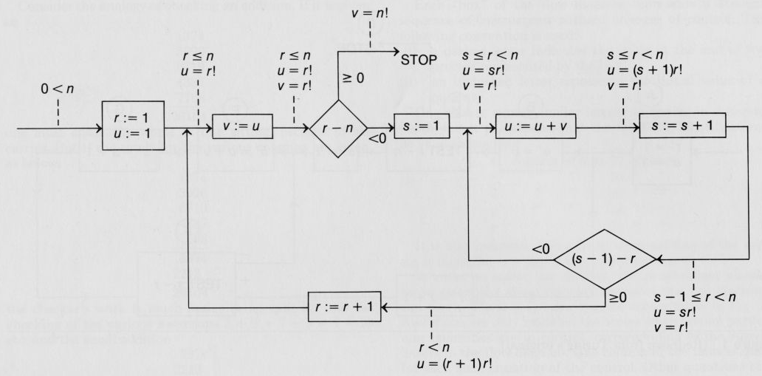
Inductive Invariants: Turing / Floyd / Hoare
3
A. M. Turing, Checking a Large Routine. In Report of a Conference on High Speed Automatic Calculating Machines, (1949).

Slide 4

Cormac Flanagan, K. Rustan M. Leino: Houdini, an Annotation Assistant for ESC/Java. FME 2001: 500-517

Slide 5
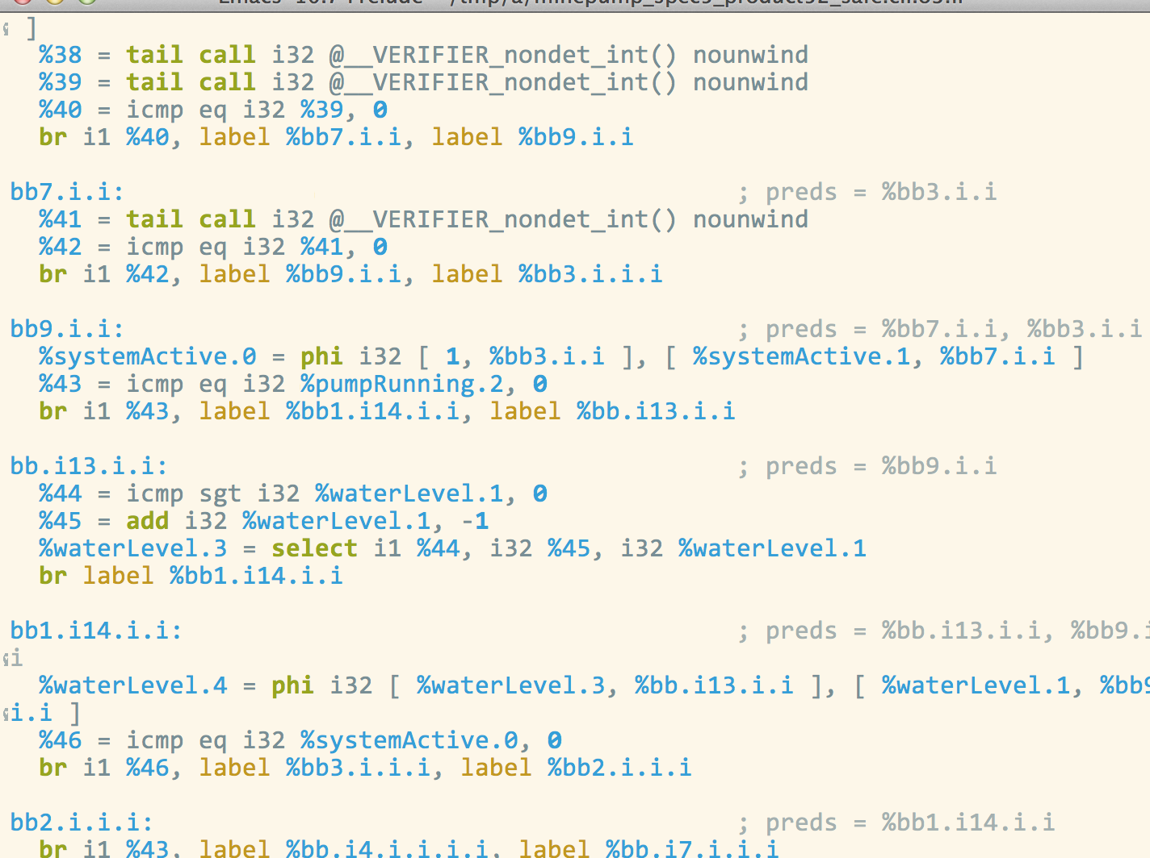

Program Verification by Houdini
Lemma3
Lemma1
Lemma2
Inductive Invariant
guess new
lemmas
No
Safe?
Yes

Slide 6
Guessing Lemmas by Evolving Approximations
approx. 1
approx. 2
approx. 3
verifier
verifier
verifier
Lemma3
Lemma1
Lemma2
Inductive Invariant
Lemma3
Lemma1
Lemma2
Inductive Invariant
Lemma3
Lemma1
Lemma2
Inductive Invariant
Safe?
No
Safe?
No
Safe?
No

Slide 7
Spacer 1.0
with Anvesh Komuravelli, Sagar Chaki, Edmund M. Clarke

Slide 8
Spacer Verification Strategy
reach(P)
error(P)
Under-approx.
➔
Abstract
➔
Under-approx.

Slide 9
Spacer Verification Strategy
reach(P)
error(P)
Under-approx.
➔
Abstract
➔
Under-approx.
➔
Refine

Slide 10
Spacer Verification Strategy
reach(P)
error(P)
Under-approx.
➔
Abstract
➔
Under-approx.
➔
Refine
➔
Abstract

Slide 11
Spacer Verification Strategy
reach(P)
error(P)
And so on …

Slide 12
Spacer Verification Strategy
reach(P) is covered
reach(P)
error(P)
Abstractions guide the SMT solver to look for general proofs

Slide 13
Mixing Over- and Under-
Under-approximations
…
A
b
s
t
r
a
c
t
…
…
…

Slide 14

Mixing Over- and Under-
Under-approximations
…
not monotonic
A
b
s
t
r
a
c
t
…
…
…

Slide 15

Mixing Over- and Under-
Under-approximations
…
non-trivial abstraction
A
b
s
t
r
a
c
t
…
…
…

Slide 16
Spacer 1.0
Program
Abstract
Under-Approximate
Refine
No
Proof-Based Abstraction
CEGAR
No
Check Safety
Feasible?
Feasible?
Safety Proof
Counterexample
Yes
Yes

Slide 17
Spacer by Example
x = y = z = w = 0;
while (*) {
if
:: x++; y += 100;
:: (x ≥ 4) -> x++; y++;
:: (y > 10w && z ≥ 100x) -> y = −y;
fi
w++; z += 10;
}
assert (!(x ≥ 4 && y ≤ 2));
if (nd ()) {x++; y += 100;}
else if (nd () && x ≥ 4) {x++; y++;}
else if (y > 10w && z ≥ 100x) {y = −y;}
else assume (0);
C-like
guarded
command

Slide 18
Spacer by Example: Under-approximation
x = y = z = w = 0;
c = 0;
while (*) {
// (y > 10w) => (z < 100x), z ≤ 100x,
// x ≤ 2, c ≤ 0 => x ≤ 0, c ≤ 1 => x ≤ 1
assume (c < 2);
if
:: x++; y += 100;
:: (x ≥ 4) -> x++; y++;
:: (y > 10w && z ≥ 100x) -> y = −y;
fi
w++; z += 10;
c += 1;
}
assert (!(x ≥ 4 && y ≤ 2));
Loop Invariants
Add Counters
Under-approximate
➔
Solve

Slide 19
Spacer by Example: Bounded Invariants
x = y = z = w = 0;
c = 0;
while (*) {
// (y > 10w) => (z < 100x), z ≤ 100x,
// x ≤ 2, c ≤ 0 => x ≤ 0, c ≤ 1 => x ≤ 1
assume (c < 2);
if
:: x++; y += 100;
:: (x ≥ 4) -> x++; y++;
:: (y > 10w && z ≥ 100x) -> y = −y;
fi
w++; z += 10;
c += 1;
}
assert (!(x ≥ 4 && y ≤ 2));
Inductive Invariant
Safe
Under-approximate
➔
Solve

Slide 20
Spacer by Example: Unbounded Invariants
x = y = z = w = 0;
c = 0;
assume (y > 10w => z < 100x, z ≤ 100x);
while (*) {
// (y > 10w) => (z < 100x), z ≤ 100x,
// x ≤ 2, c ≤ 0 => x ≤ 0, c ≤ 1 => x ≤ 1
assume (c < 2);
if
:: x++; y += 100;
:: (x ≥ 4) -> x++; y++;
:: (y > 10w && z ≥ 100x) -> y = −y;
fi
w++; z += 10;
c += 1;
assume (y > 10w => z < 100x, z ≤ 100x);
}
assert (!(x ≥ 4 && y ≤ 2));
Specific to under-approx.
Preserved!
Extract Unbounded
Invariants
Depend on counter
Strengthen
with
Invariants
Under-approximate
➔
Solve
➔
Feasible?

Slide 21
Spacer by Example: Is Proof Feasible?
x = y = z = w = 0;
c = 0;
assume (y > 10w => z < 100x, z ≤ 100x);
while (*) {
// (y > 10w) => (z < 100x), z ≤ 100x,
if
:: x++; y += 100;
:: (x ≥ 4) -> x++; y++;
:: (y > 10w && z ≥ 100x) -> y = −y;
fi
w++; z += 10;
c += 1;
assume (y > 10w => z < 100x, z ≤ 100x);
}
assert (!(x ≥ 4 && y ≤ 2));
Does not prove
the assertion
Under-approximate
➔
Solve
➔
Feasible?
NO

Slide 22
Spacer by Example: Abstraction
x = y = z = w = 0;
c = 0;
assume (y > 10w => z < 100x, z ≤ 100x);
while (*) {
// (y > 10w) => (z < 100x), z ≤ 100x,
// x ≤ 2, c ≤ 0 => x ≤ 0, c ≤ 1 => x ≤ 1
assume (c < 2);
if
:: x++; y += 100;
:: (x ≥ 4) -> x++; y++;
:: (y > 10w && z ≥ 100x) -> y = −y;
fi
w++; z += 10;
c += 1;
assume (y > 10w => z < 100x, z ≤ 100x);
}
assert (!(x ≥ 4 && y ≤ 2));
Redundant
Under-approximate
➔
Solve
➔
Feasible?
NO
➔
Abstract

Slide 23
Spacer by Example: Abstraction
x = y = z = w = 0;
c = 0;
assume (y > 10w => z < 100x, z ≤ 100x);
while (*) {
// (y > 10w) => (z < 100x), z ≤ 100x,
// x ≤ 2, c ≤ 0 => x ≤ 0, c ≤ 1 => x ≤ 1
assume (c < 2);
if
:: x++; y = *;
:: (x ≥ 4) -> x++; y = *;
:: (y > 10w && z ≥ 100x) -> y = *;
fi
w = *; z = *;
c += 1;
assume (y > 10w => z < 100x, z ≤ 100x);
}
assert (!(x ≥ 4 && y ≤ 2));
Fails
Enlarge error
Under-approximate
➔
Solve
➔
Feasible?
NO
➔
Abstract

Slide 24
Spacer by Example: Abstraction
x = y = z = w = 0;
c = 0;
assume (y > 10w => z < 100x, z ≤ 100x);
while (*) {
// (y > 10w) => (z < 100x), z ≤ 100x,
// x ≤ 2, c ≤ 0 => x ≤ 0, c ≤ 1 => x ≤ 1
assume (c < 2);
if
:: x++; y = *;
:: (x ≥ 4) -> x++; y = *;
:: (y > 10w && z ≥ 100x) -> y = *;
fi
w = *; z = *;
c += 1;
assume (y > 10w => z < 100x, z ≤ 100x);
}
assert (!(x ≥ 4 && true));
Under-approximate
➔
Solve
➔
Feasible?
NO
➔
Abstract

Slide 25
Spacer by Example: Under-Approximate (again)
x = y = z = w = 0;
c = 0;
assume (y > 10w => z < 100x, z ≤ 100x);
while (*) {
assume (c < 4);
if
:: x++; y = *;
:: (x ≥ 4) -> x++; y = *;
:: (y > 10w && z ≥ 100x) -> y = *;
fi
w = *; z = *;
c += 1;
assume (y > 10w => z < 100x, z ≤ 100x);
}
assert (!(x ≥ 4 && true));
Counterexample!
Increment x to 4
Choose y arbitrarily
Concretize
Concrete control
path is infeasible
Under-approximate
➔
Solve
➔
Feasible?
NO
➔
Refine

Slide 26
Spacer by Example: Refinement
x = y = z = w = 0;
c = 0;
assume (y > 10w => z < 100x, z ≤ 100x);
while (*) {
assume (c < 4);
if
:: x++; y += 100;
:: (x ≥ 4) -> x++; y++;
:: (y > 10w && z ≥ 100x) -> y = −y;
fi
w = *; z = *;
c += 1;
assume (y > 10w => z < 100x, z ≤ 100x);
}
assert (!(x ≥ 4 && y ≤ 2));
Under-approximate
➔
Solve
➔
Feasible?
NO
➔
Refine

Slide 27
Spacer by Example: Safe
x = y = z = w = 0;
c = 0;
assume (y > 10w => z < 100x, z ≤ 100x);
while (*) {
// (y > 10w) => (z < 100x), z ≤ 100x
// y > 0, (x > 0) => (y ≥ 100)
assume (c < 4);
if
:: x++; y += 100;
:: (x ≥ 4) -> x++; y++;
:: (y > 10w && z ≥ 100x) -> y = −y;
fi
w = *; z = *;
c += 1;
assume (y > 10w => z < 100x, z ≤ 100x);
}
assert (!(x ≥ 4 && y ≤ 2));
Unbounded
Inductive Invariant
Safe
Under-approximate
➔
Solve
➔
Feasible?
YES

Slide 28
Spacer 1.0
Program
Abstract
Under-Approximate
Refine
No
Proof-Based Abstraction
CEGAR
No
Check Safety
Feasible?
Feasible?
Safety Proof
Counterexample
Yes
Yes

Slide 29
Programs, Cexs, Invariants
A program P = (V, Init, Tr, Bad)
P is UNSAFE if and only if there exists a number N s.t.
P is SAFE if and only if there exists a safe inductive invariant Inv s.t.
Inductive
Safe

Slide 30
Verification by Inductive Invariants
Find a formula Inv(u) such that

Slide 31
Spacer Verification Scheme
Find formulas Inv(u), T(u,v,w), and a number k such that
T abstracts τ
Under-approx
Inductive invariant
Safe

Slide 32
(Brief) Technical Details
Synthesizing Invariants for Bounded Programs
  in implementation, we use Z3/PDR engine
  in theory, any Horn / DAG-interpolation solver can be used
Abstraction
  localization computed by Minimial Unsatisfiable Subset (MUS)
  relative to already known invariants (!)
Counterexample-Guided Refinement
  feasibility check by Bounded Model Checking along a CFG path
  refinement by MUS
Proof Feasibility
  by Maximal Inductive Subset (MIS) of bounded invariants
  reduce MIS to multiple MUS calls
Incremental Solving
  under-approx, abstraction, feasibility all share a single SMT context

Slide 33
Results on SV-COMP’13 Benchmarks
Abstraction did not help
for UNSAFE
benchmarks are not
super challenging

Slide 34
Results on SV-COMP’13 Benchmarks

Slide 35

Results on SV-COMP’13 Benchmarks
~1 min.
Not very meaningful to compare

Slide 36

Results on SV-COMP’13 Benchmarks
< 5 min.
mixed results

Slide 37

Results on SV-COMP’13 Benchmarks
Advantage!

Slide 38
Results on SV-COMP’13 Benchmarks
Advantage!
Time-out
Mem-out

Slide 39
Open Challenges
Synthesis for verification
Verification under assumptions
Encoding other forms of under-approximation

Slide 40
Synthesis for verification
What is “easier” to solve: Inv₁ or Inv₂?
Inv₂ is more expressive
Challenge: Automatically synthesize “good” specification code?

Slide 41
Verification under assumptions
Find Inv(u,c) that depends the least on the assumption c’ < k
What is a good definition of minimal dependence?

Slide 42
Encoding other forms of under-approximation
We know how to bound loop iterations
What are other good sources of under-approximation
  input non-determinism
  bit-width
  call-stack depth (i.e., stratified inlining)
  context switches (i.e., context-bounded analysis)
  ???
How to encode an under-approximation efficiently?

Slide 43

FrankenBit
with Anton Belov and Joao Marques-Silva

Slide 44
Bit-Precise Verification is Hard
Bounded Model Checking
  CBMC, Boolector, LLBMC, ESBMC, …
  efficient discovery of counter-examples
  no invariants!
Propositional Verification (Hardware)
  Interpolation, IC3, PDR, ABC, …
  efficient synthesis of propositional invariants
  does not scale to bit-precise verification of software
Linear Arithmetic Verification (Software)
  Impact, UFO, CPAChecker, Duality, Blast, GPDR, …
  efficient synthesis of arithmetic invariants
  not bit-precise (not sound!)
  is often sufficient (e.g., UFO at SV-COMP’13 and ‘14)

Slide 45
But aren’t
bit-vectors = bit-blasting?

Slide 46
Typical Bit-vector Decision Procedure
Simplify
Bit-blast
SAT
B2P
B2P is satisfiability preserving (only!)
Bit-blast (by itself) is not efficient

Slide 47
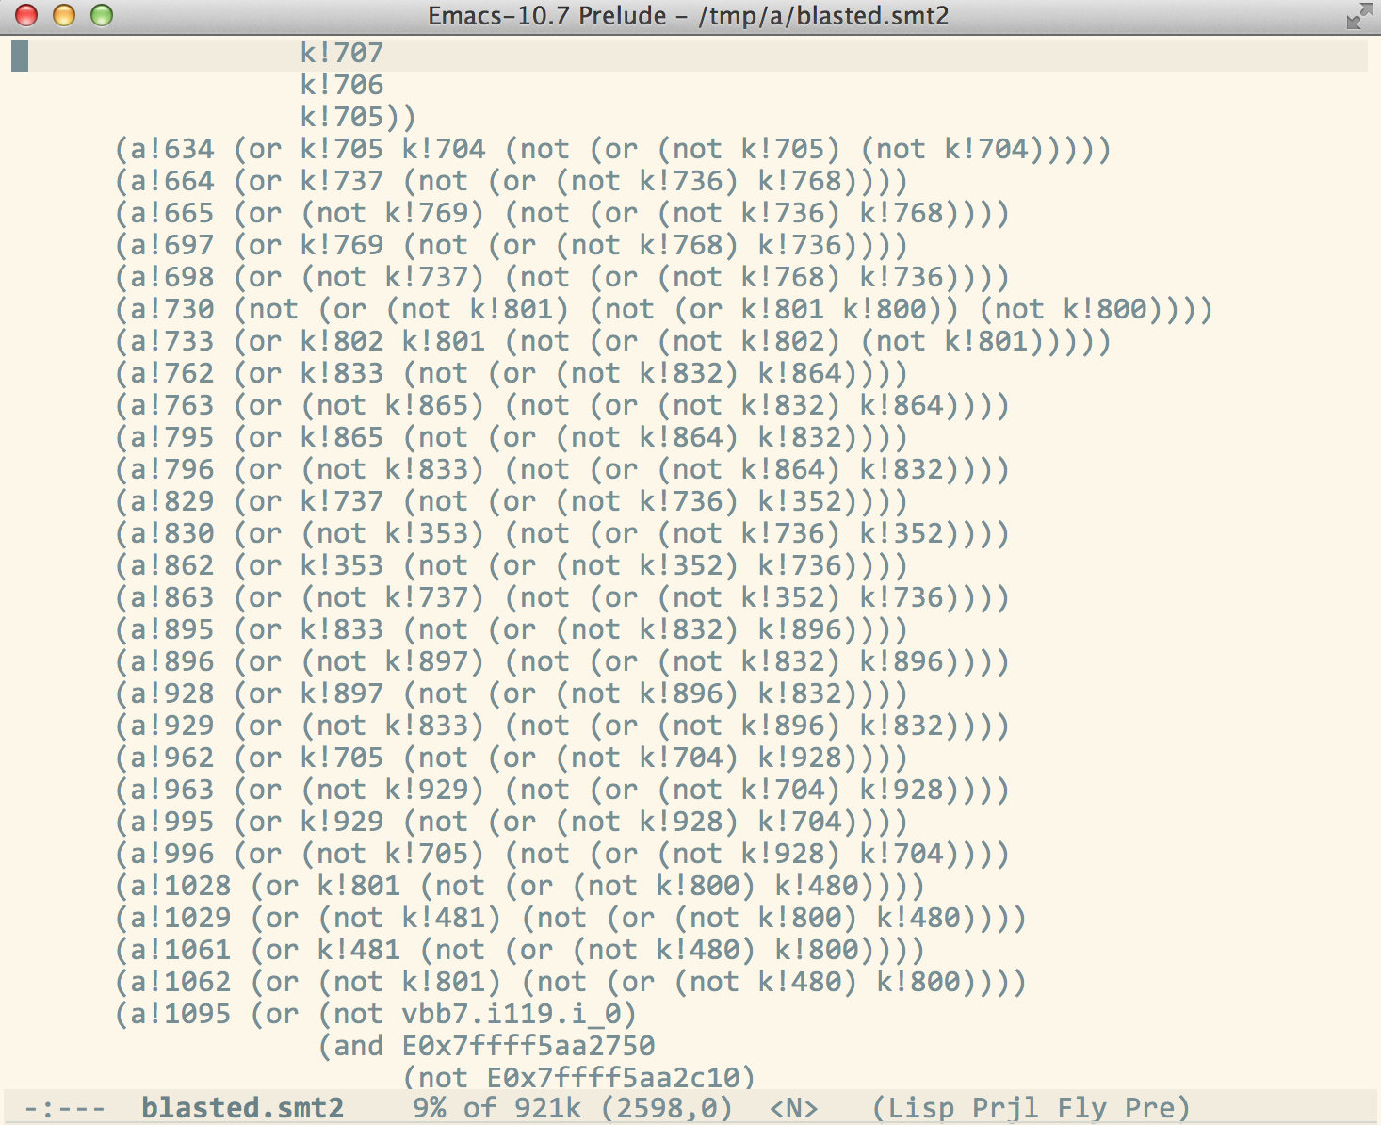
Safety Verification by Bit-Blasting
propositional verifier
Bit-blast
Verify
Correct, but does not scale

Slide 48
Safety Verification by B2P
B2P
True
Verify
Efficient, but…
  B2P only preserves satisfiability
  Original circuit is reduced (abstracted) too much
  Hard to track correspondence between input and output

Slide 49
Bit-blasting looses all structure!
Lack of structure makes it difficult to generalize

Slide 50
Our Key Idea: Use Generate and Check Alg.
Given an input program P with a safety property ¬Bad
Generate a candidate invariant Cand by verifying ¬Bad on a “simpler” approximation P_{simple} of P
Compute the Maximal Inductive Subset Inv of Cand relative to P using bit-precise reasoning
Strengthen Inv using a bit-precise (but possibly slow) verification engine until (Inv ⇒ ¬Bad)

Slide 51

Misper in a Nutshell
Needs
validation
Adapt unsound arithmetic reasoning to guess bit-precise invariants
No + Cex
Unsound
Program P_{LA}
Approximate
LA Verifier
Program P
+
Property
Candidate C_{LA}
Invariant I_{BIT}
BIT Verifier
Adapt using MIS
Yes +
Certificate C_{BIT}
Sound
No + Cex

Slide 52
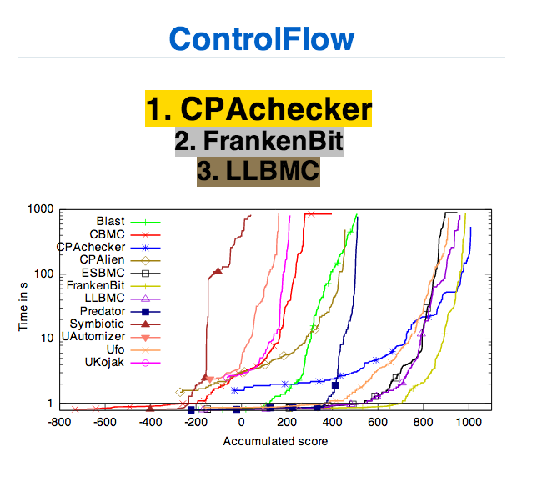
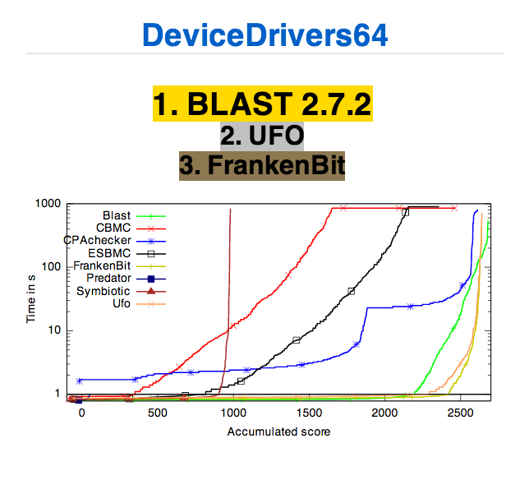
FrankenBit: Bit-Precise Verification w/ Many Bits
Misper to synthesize bit-precise invariants
LLBMC to search for counterexamples
Silver and Bronze medals at SV-COMP 2014
http://sv-comp.sosy-lab.org/2014/results/index.php

Slide 53
Conclusion
Sound reasoning from unsound approximations
  Use Linear Arithmetic to guess good invariants
  Use efficient bit-vector decision procedures to validate invariants
  Use efficient propositional Minimal Unsatisfiable Subset extractor to find Maximal Inductive Subset
  Use inefficient bit-precise reasoning to complete the proof
Works well on SV-COMP (non bit-vector specific) benchmarks
  probably because the properties are mostly bit-vector agnostic
  e.g., API usage in Linux Device Drivers
Integrated in FrankenBit: http://arieg.bitbucket.org/fbit

Slide 54
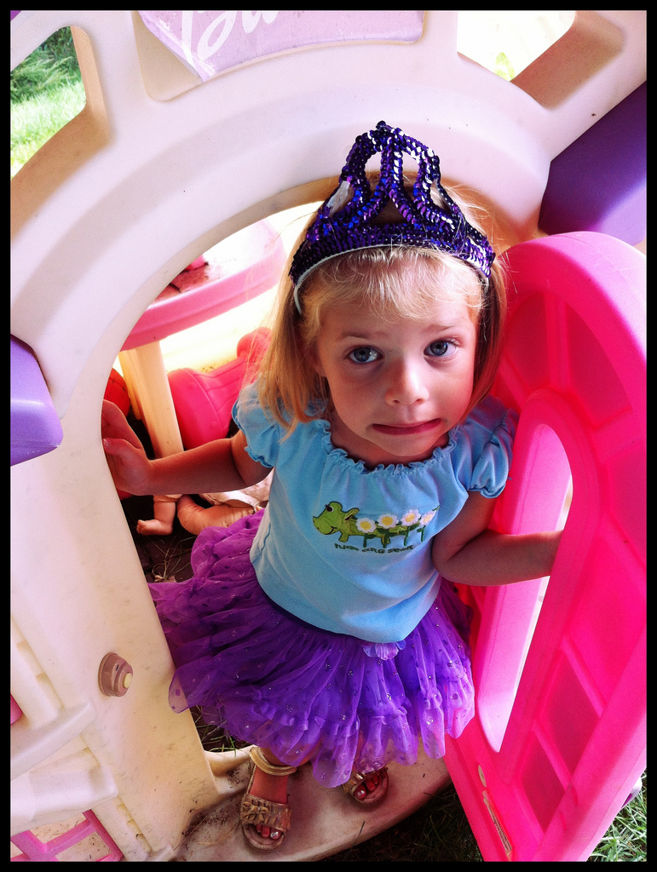
?
?
?
?
?
?

Slide 55
Contact Information
Arie Gurfinkel Senior Researcher SEI / CMU Telephone: +1 412-268-5800 Email: info@sei.cmu.edu | U.S. Mail Software Engineering Institute Customer Relations 4500 Fifth Avenue Pittsburgh, PA 15213-2612 USA
Web www.sei.cmu.edu www.sei.cmu.edu/contact.cfm | Customer Relations Email: info@sei.cmu.edu Telephone: +1 412-268-5800 SEI Phone: +1 412-268-5800 SEI Fax: +1 412-268-6257

